Slide 1

RPS x
Rock paper scissor X-TREME
By: Group 6

Slide 2

Team Members & Roles
Ikenna Acholonu – Project Manager
Christopher Rodbourne - Front End Developer
Suvrat Jain - Mobile App
Daniel Schiff - Mobile App
Tyler Cuervo – API/Database
Greg Eugene - Front End Developer
Alexander Meade - API/Database

Slide 3
The Pitch
RPS X-treme is the next evolution of your favorite juvenile game - now you can settle your petty disputes from your handheld device, or set up tournaments to determine the alpha member of your entire friend group. To be exact, RPS X-treme is a web-based Android application that makes it possible to set up/join lobbies for rock-paper-scissors matches/tournaments, and also keeps track of a variety of player performance statistics. Players will be able to log in and make or join a lobby.

Slide 4
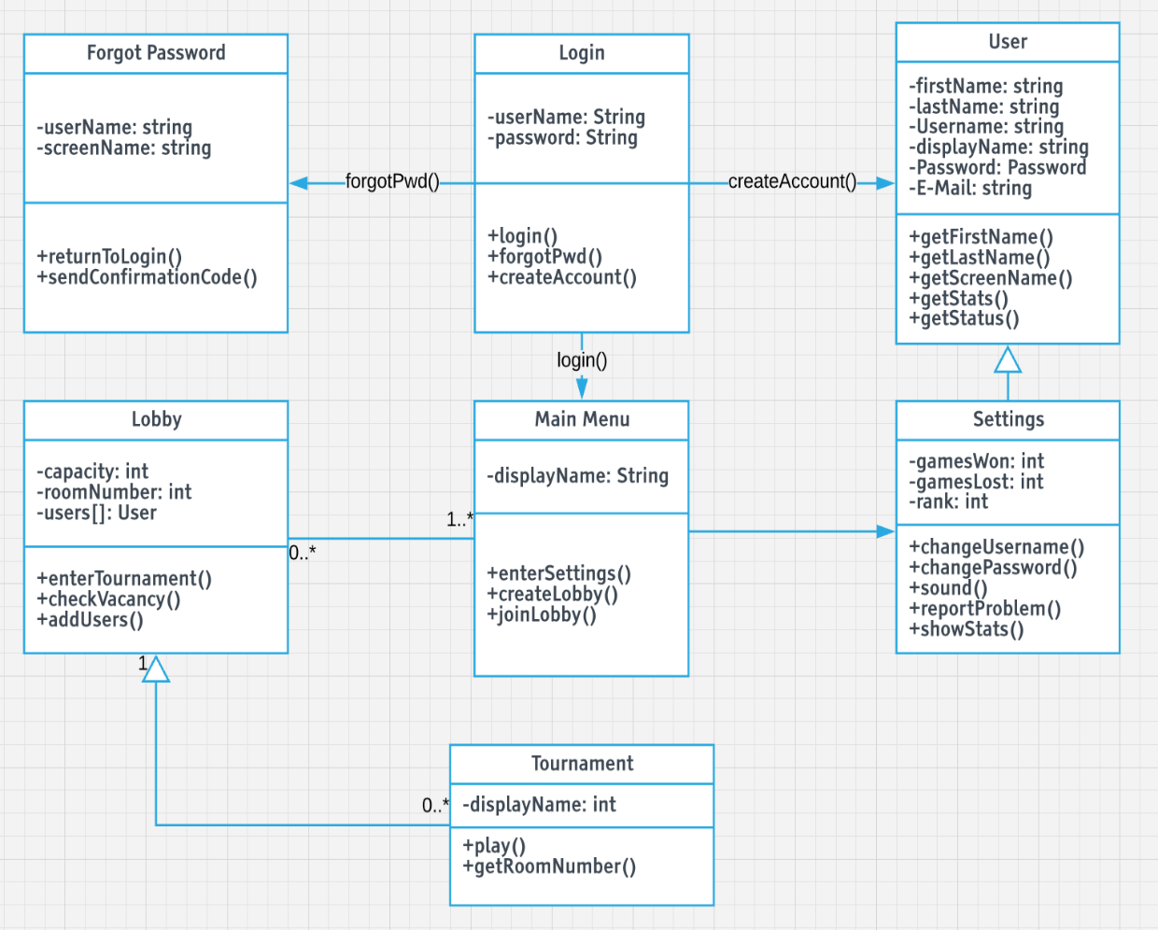
UML Diagrams
Use Case

Slide 5
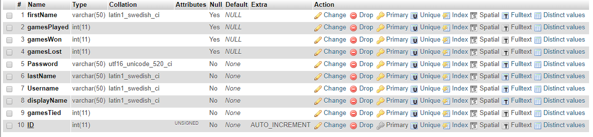
Database - Example
Current user database entries
An additional table for the leaderboard may or may not be utilized

Slide 6
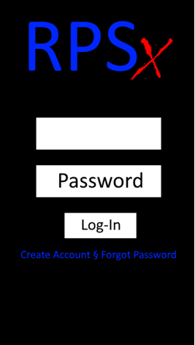
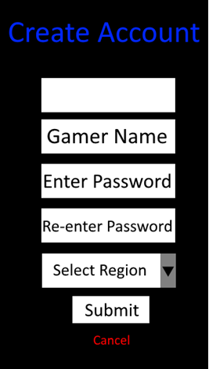
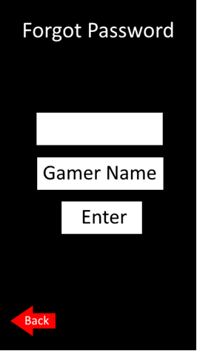
Proof of Concept – Mobile App
Username
Username
Username

Slide 7
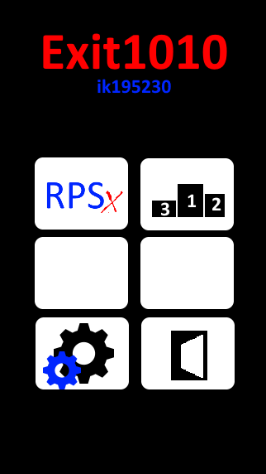
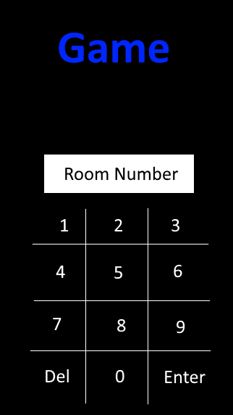
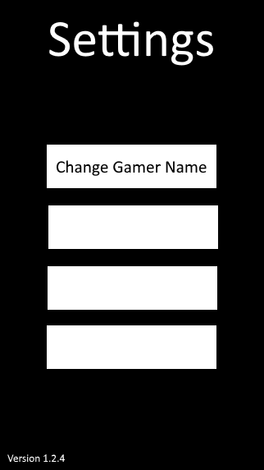
Proof of Concept – Mobile App
Change Password
Sound Settings
Report a Problem

Slide 8
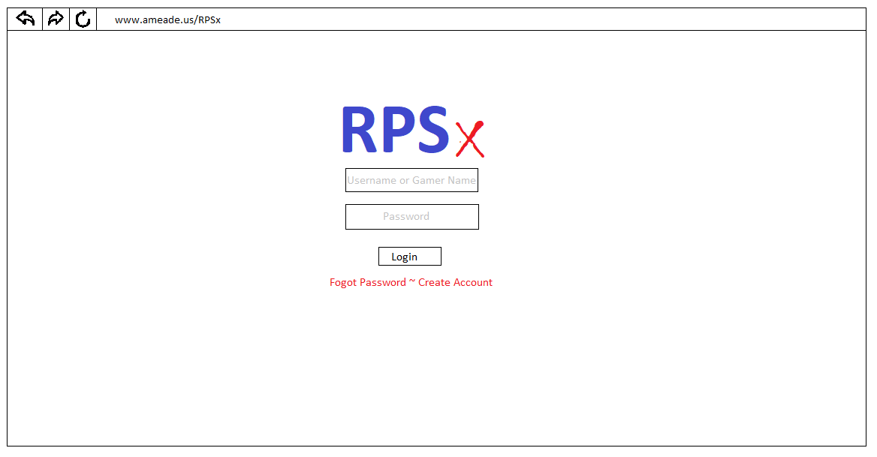
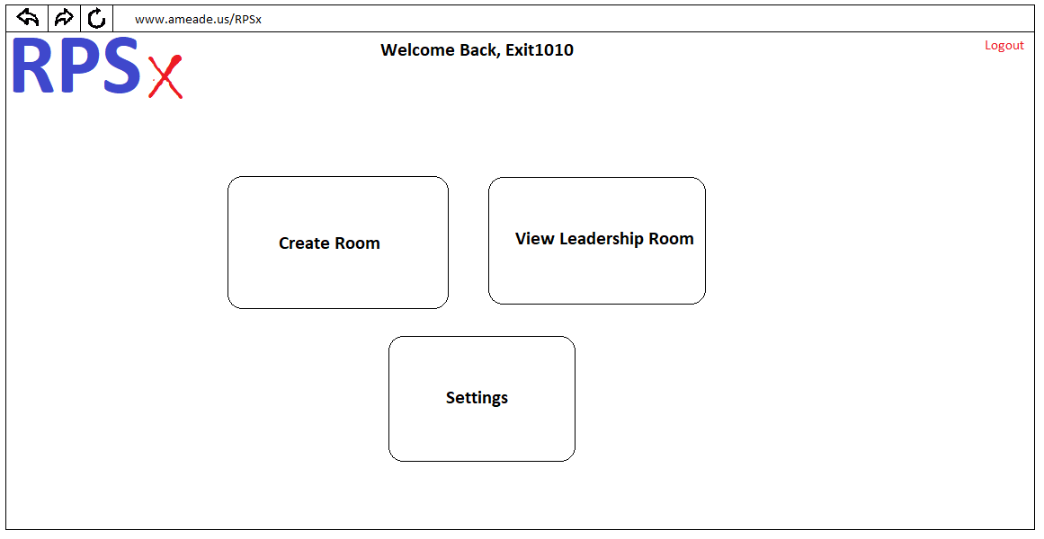
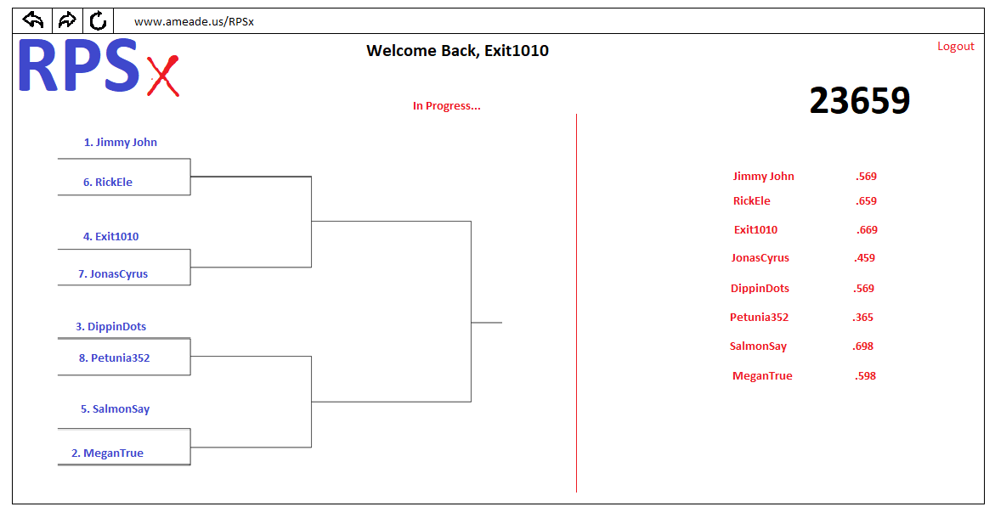
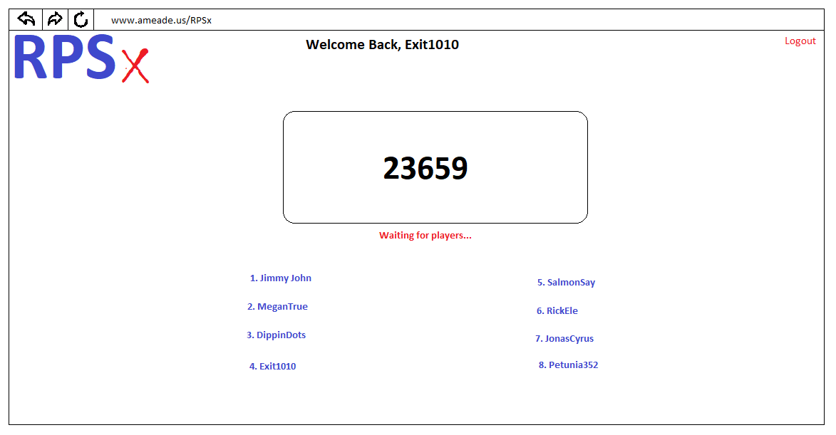
Proof of Concept – Webpage

Slide 9
Questions?

